Slide 1
Investigation of Nfe2l1 in muscle metabolism using mouse multi-omics data in gastrocnemius and soleus
Nick Diercksen, supervised by Phong Nguyen
February 10, 2023

Slide 2
Agenda
Outline
Data
First results
DEA
GSEA

Slide 3
Outline
Differential Expression Analysis (DEA)
Gene Set Enrichment Analysis (GSEA)
Multi-omics Analysis ⏳
R Shiny app for diff. gene expr. Analysis “on the fly”

Slide 4
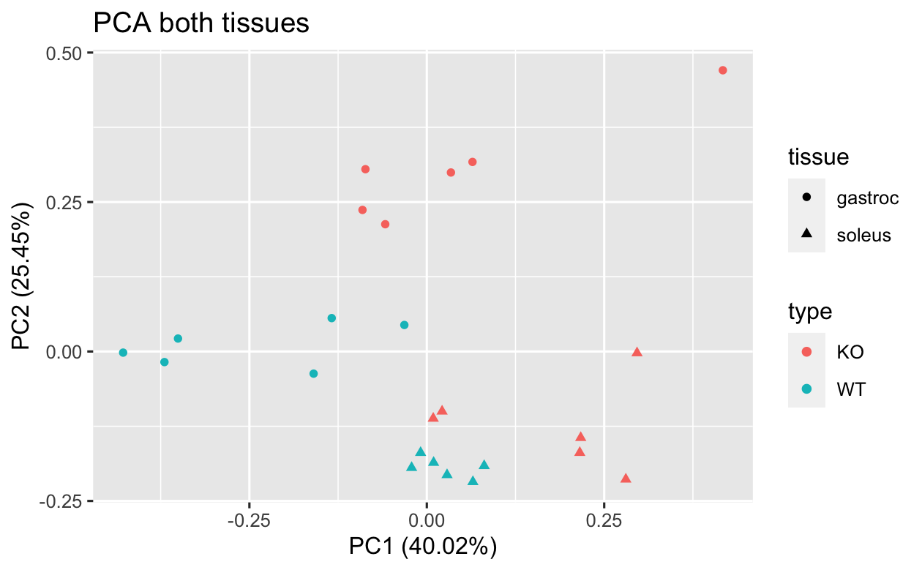
Data
Notes:
grouped nicely
the PCA axes explain a lot of variation

Slide 5
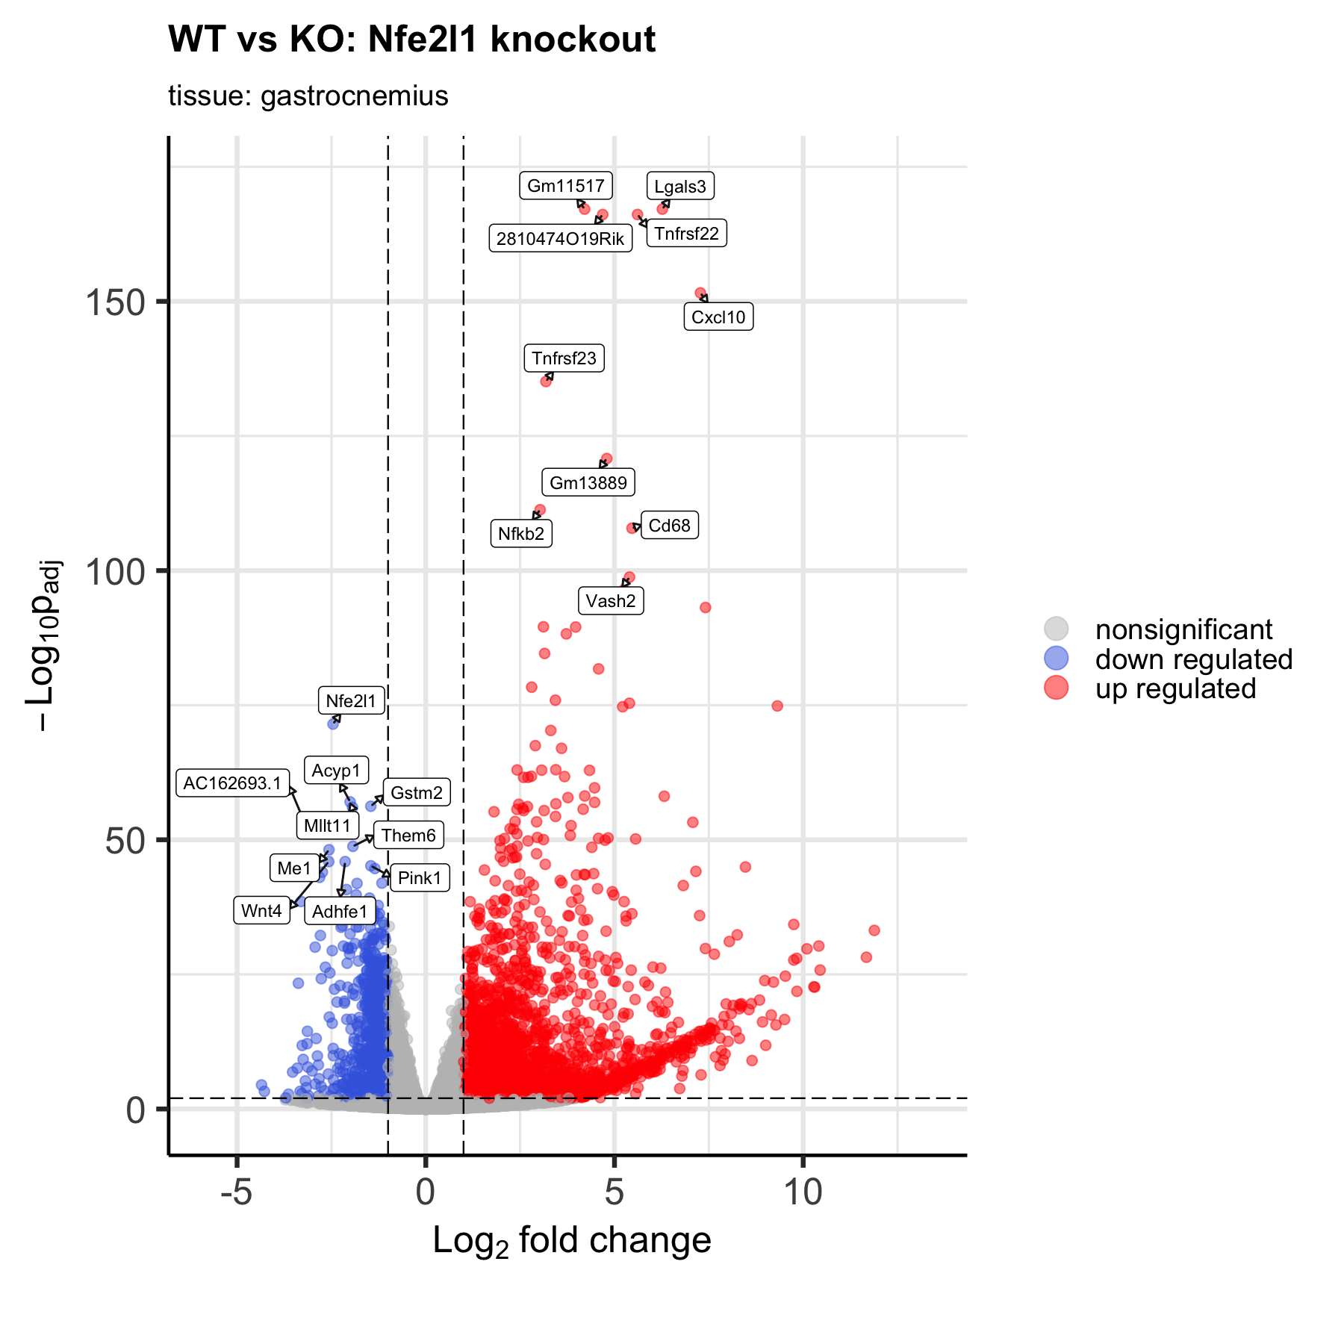
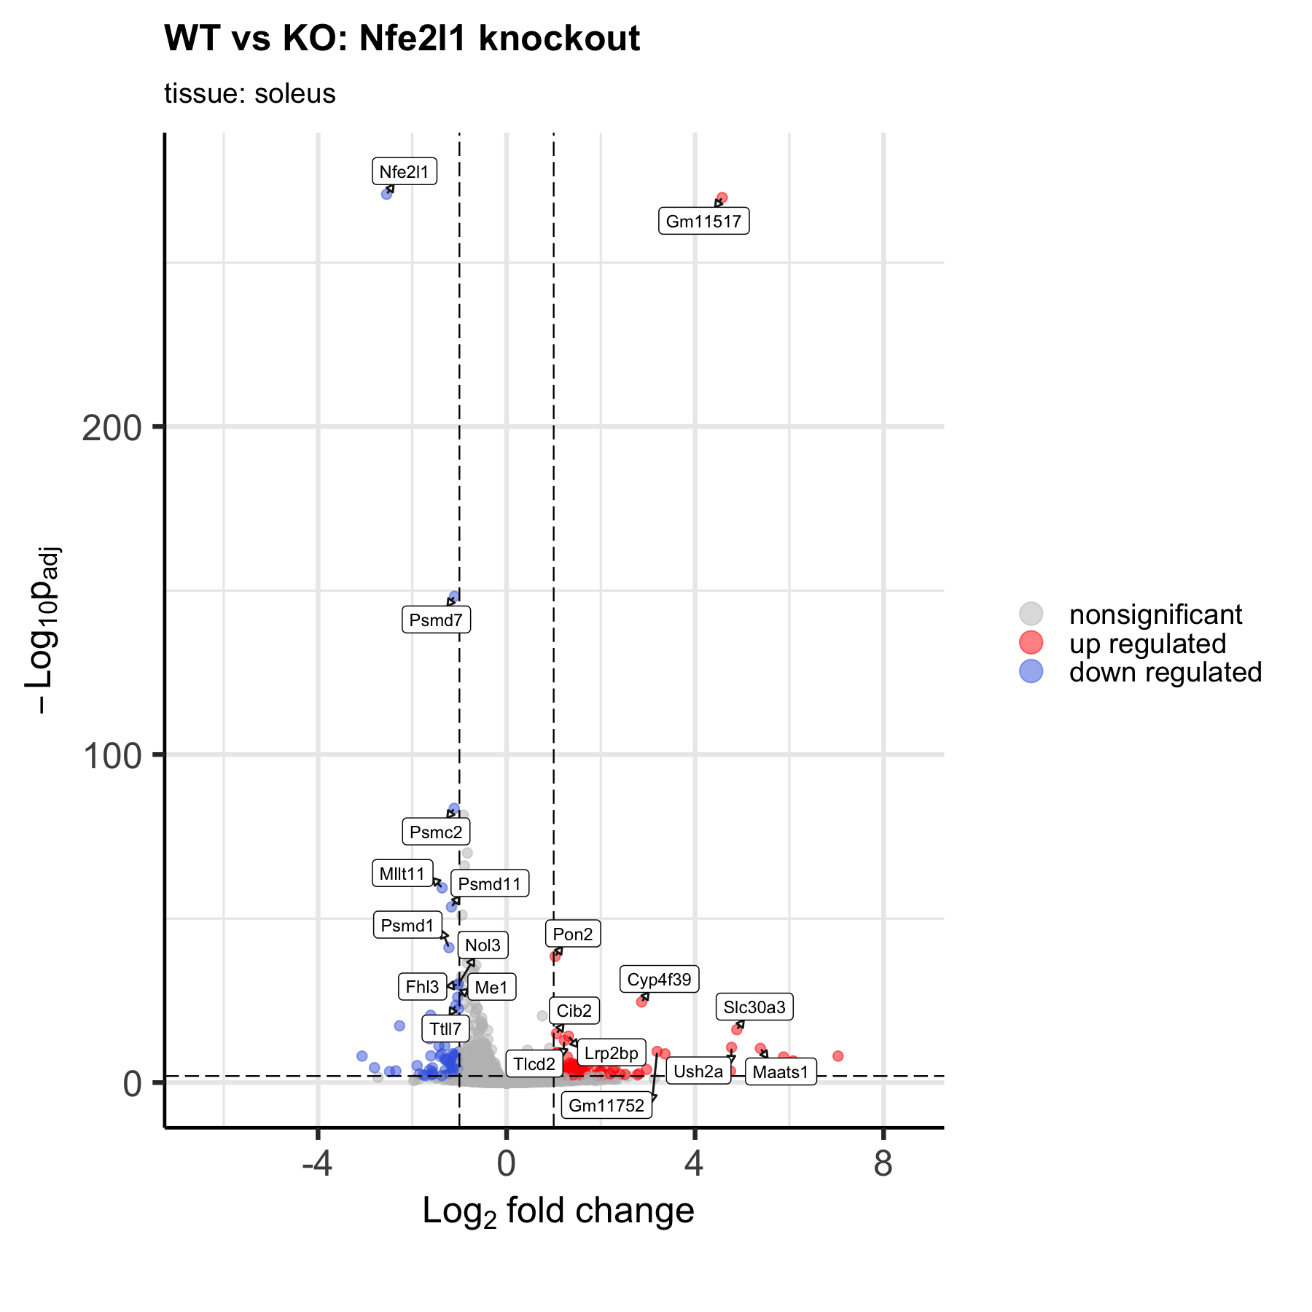
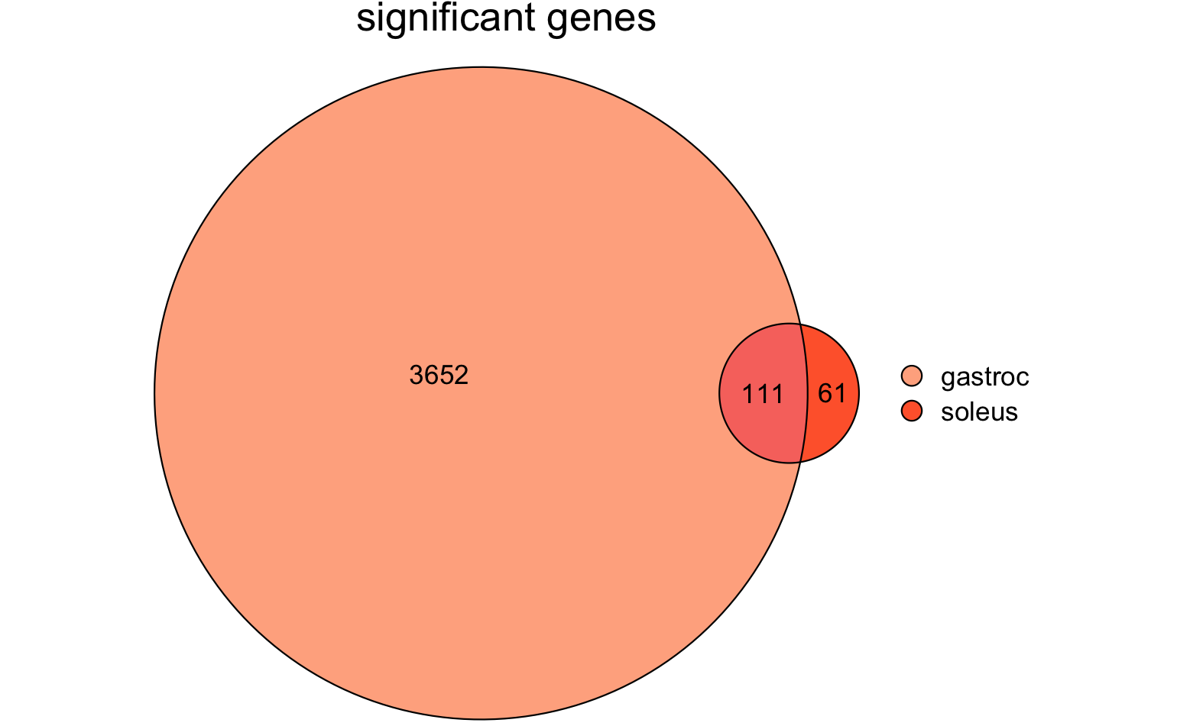
DEA: volcano Plot

Slide 6
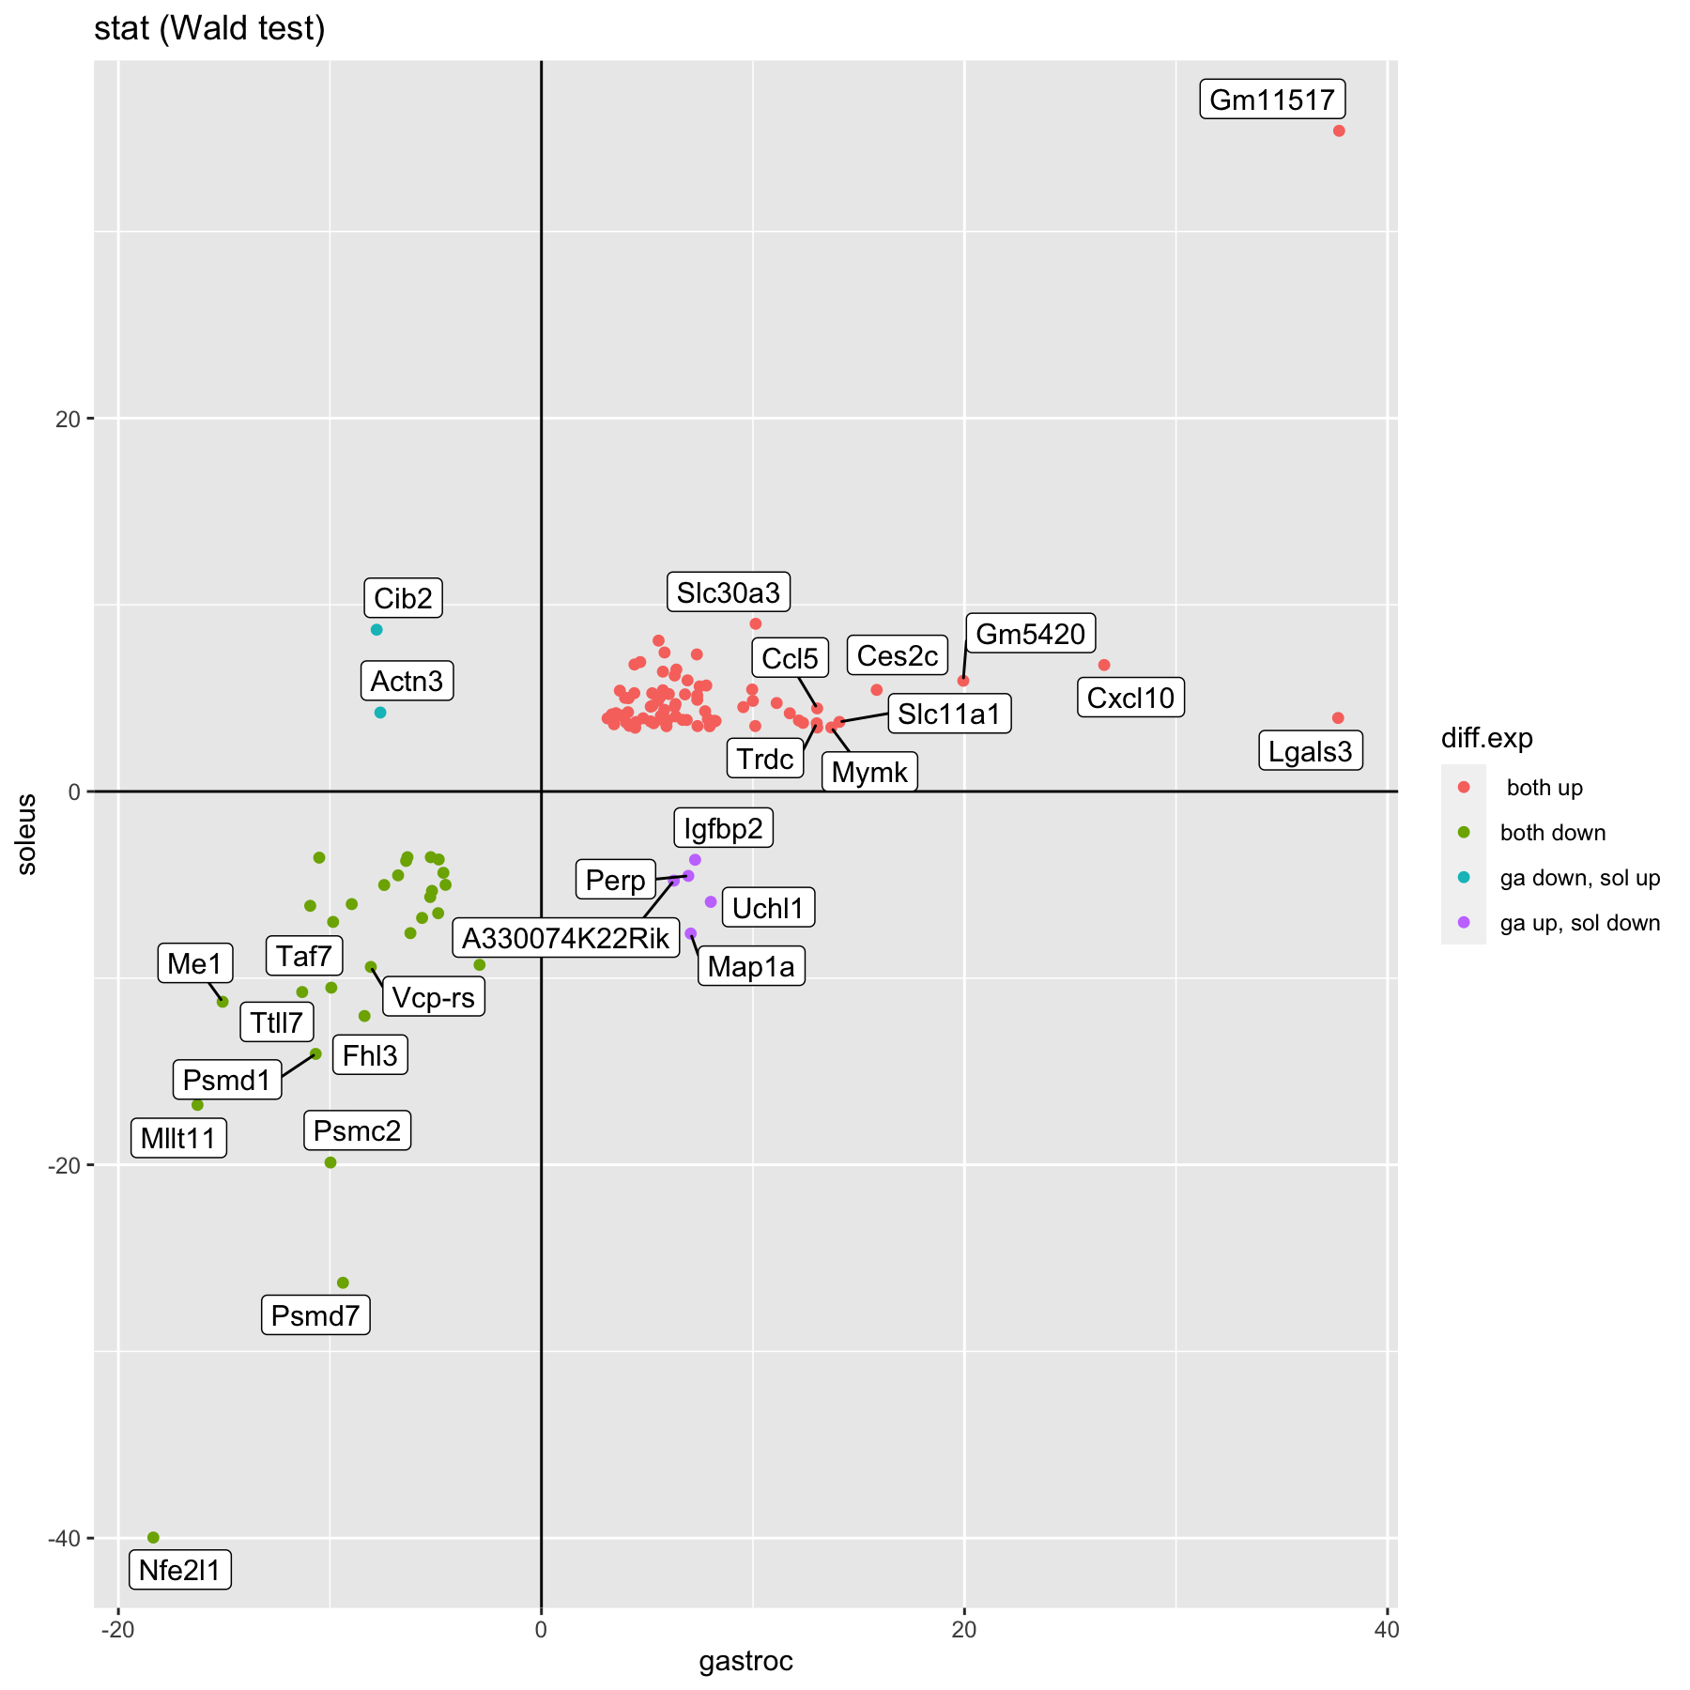
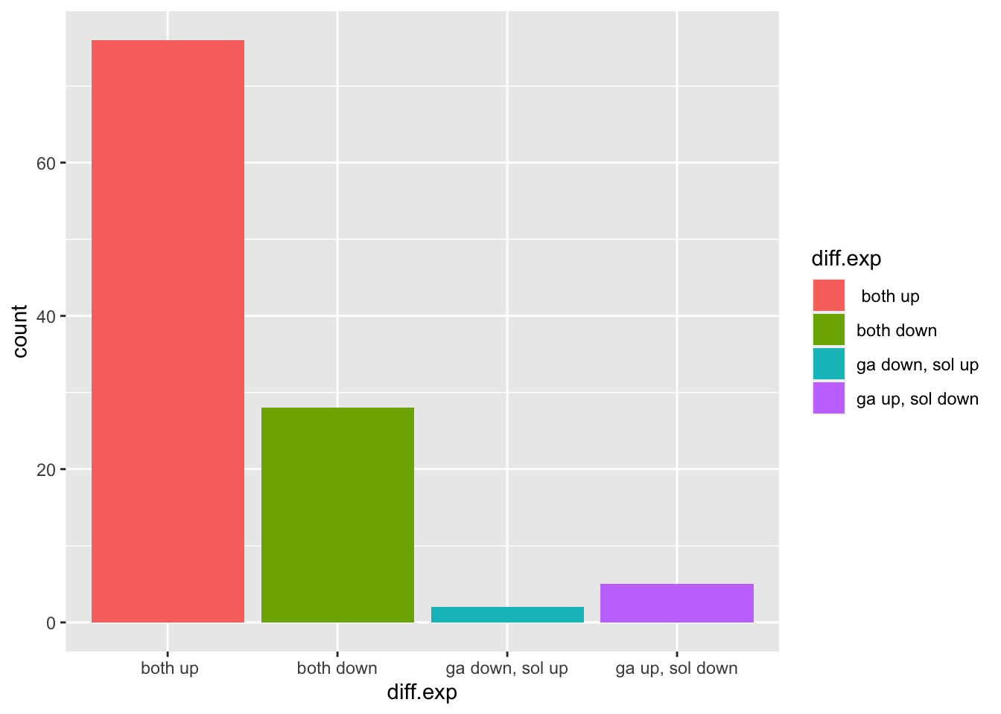
DEA:
!boxplots for each category

Slide 7
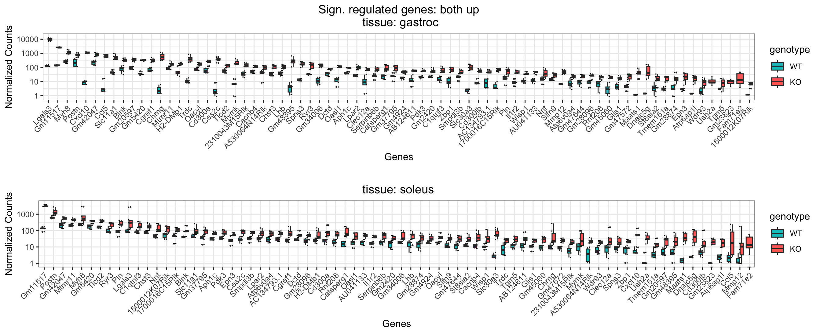
DEA: boxplots - upregulated

Slide 8
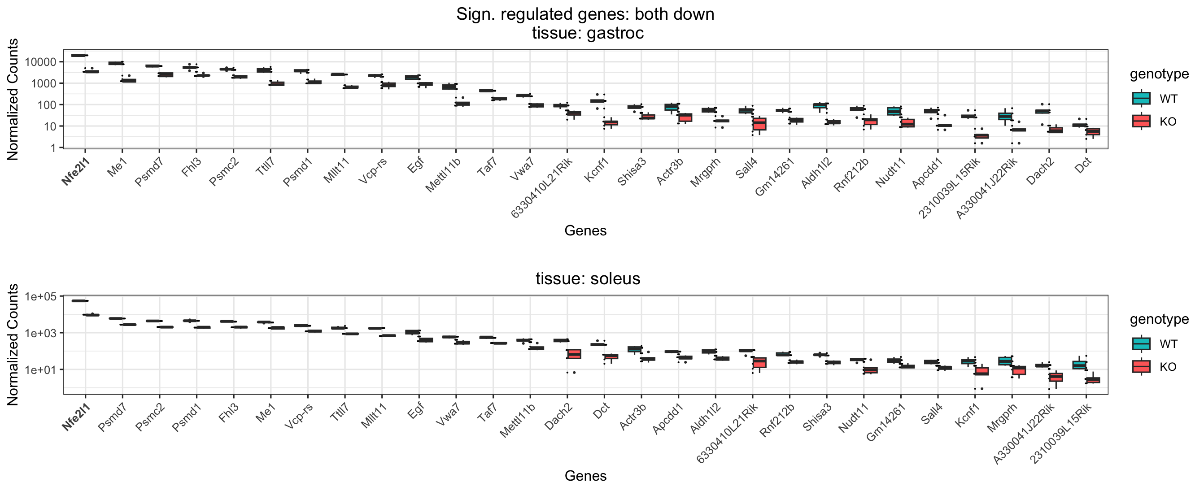
DEA: boxplots - downregulated

Slide 9
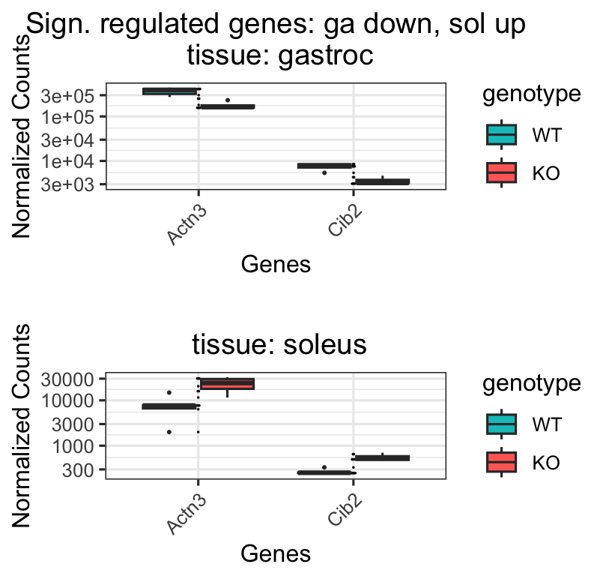
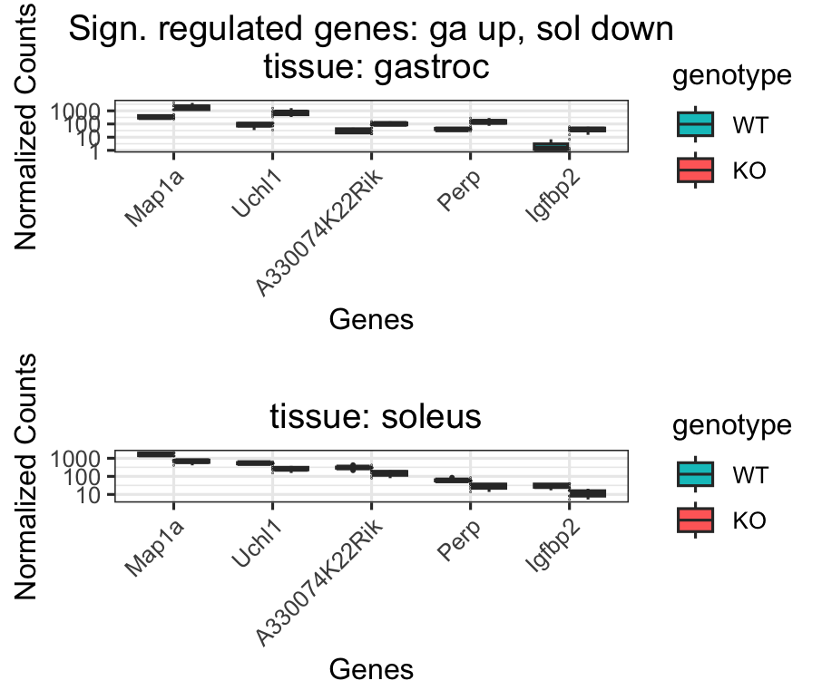
DEA: boxplots - invers

Slide 10
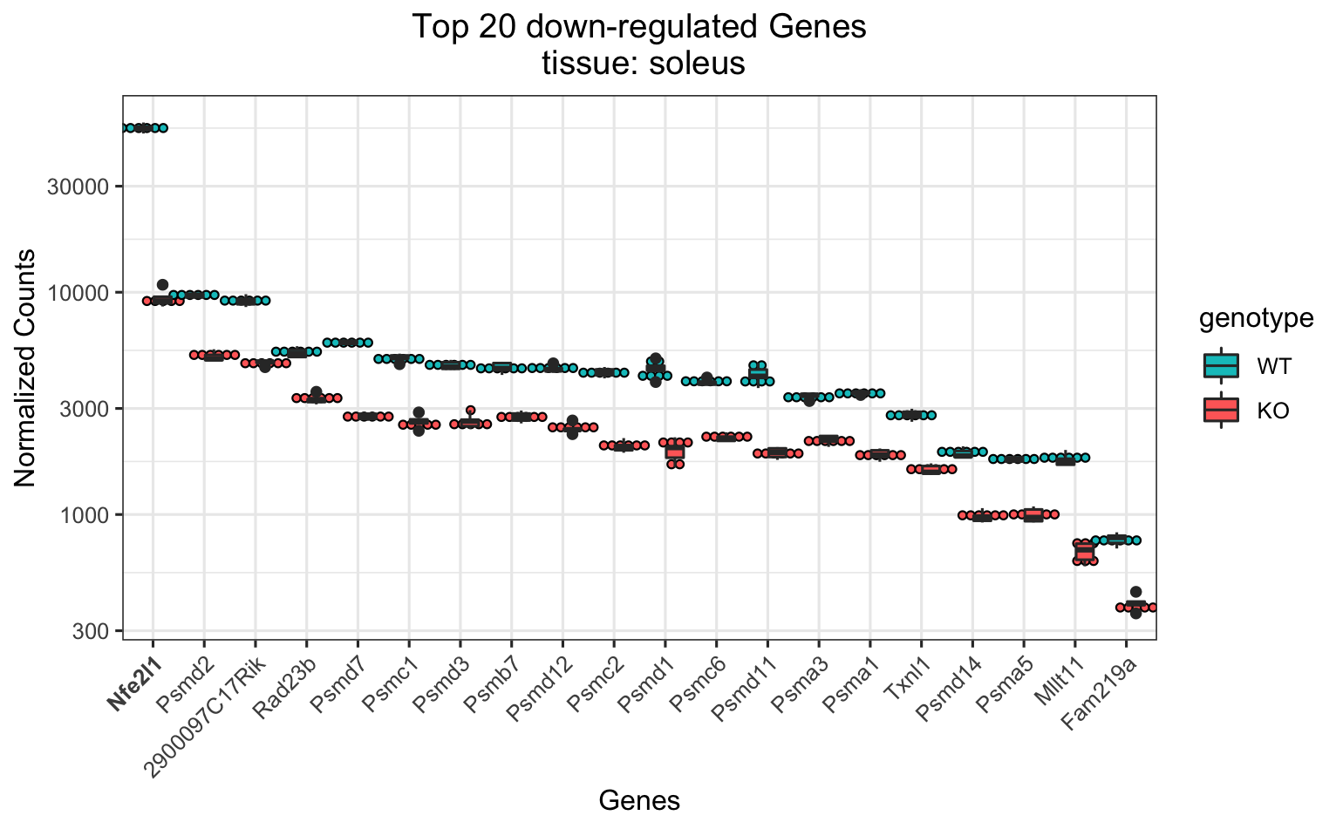
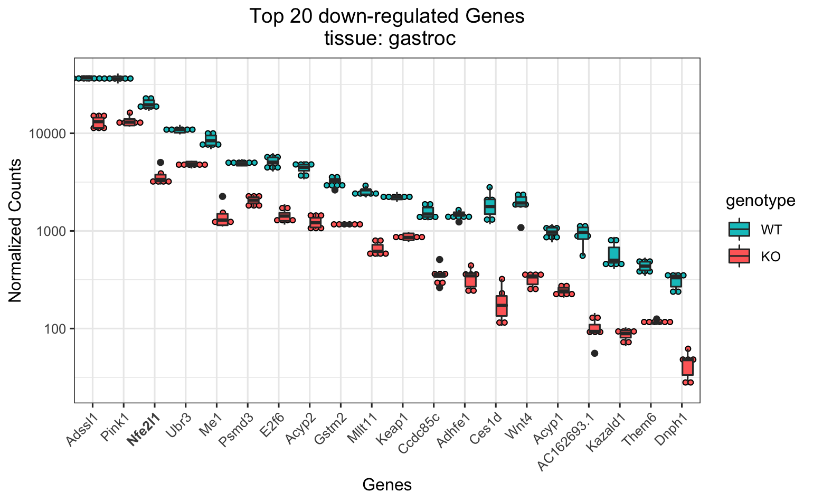
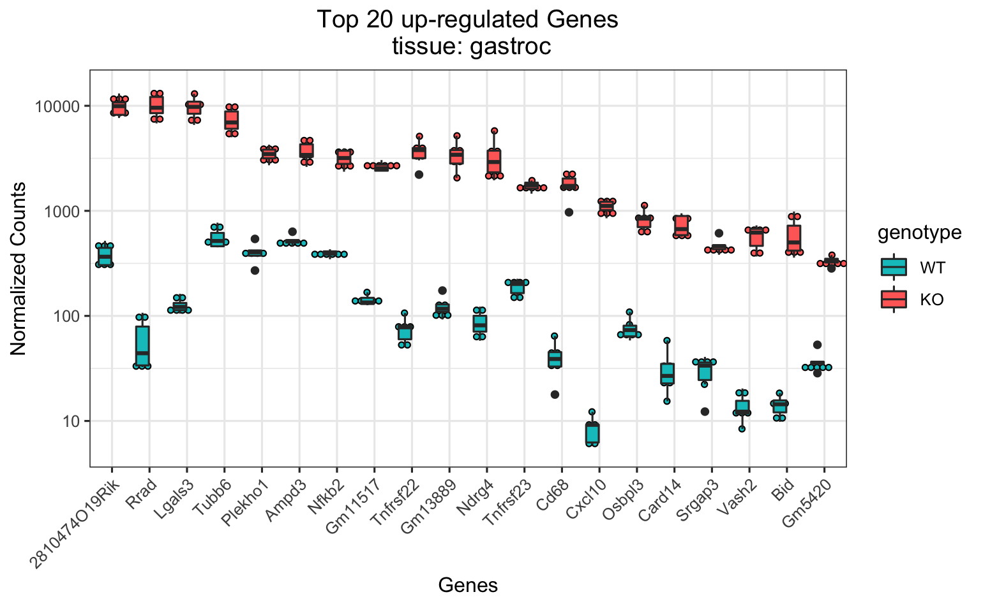
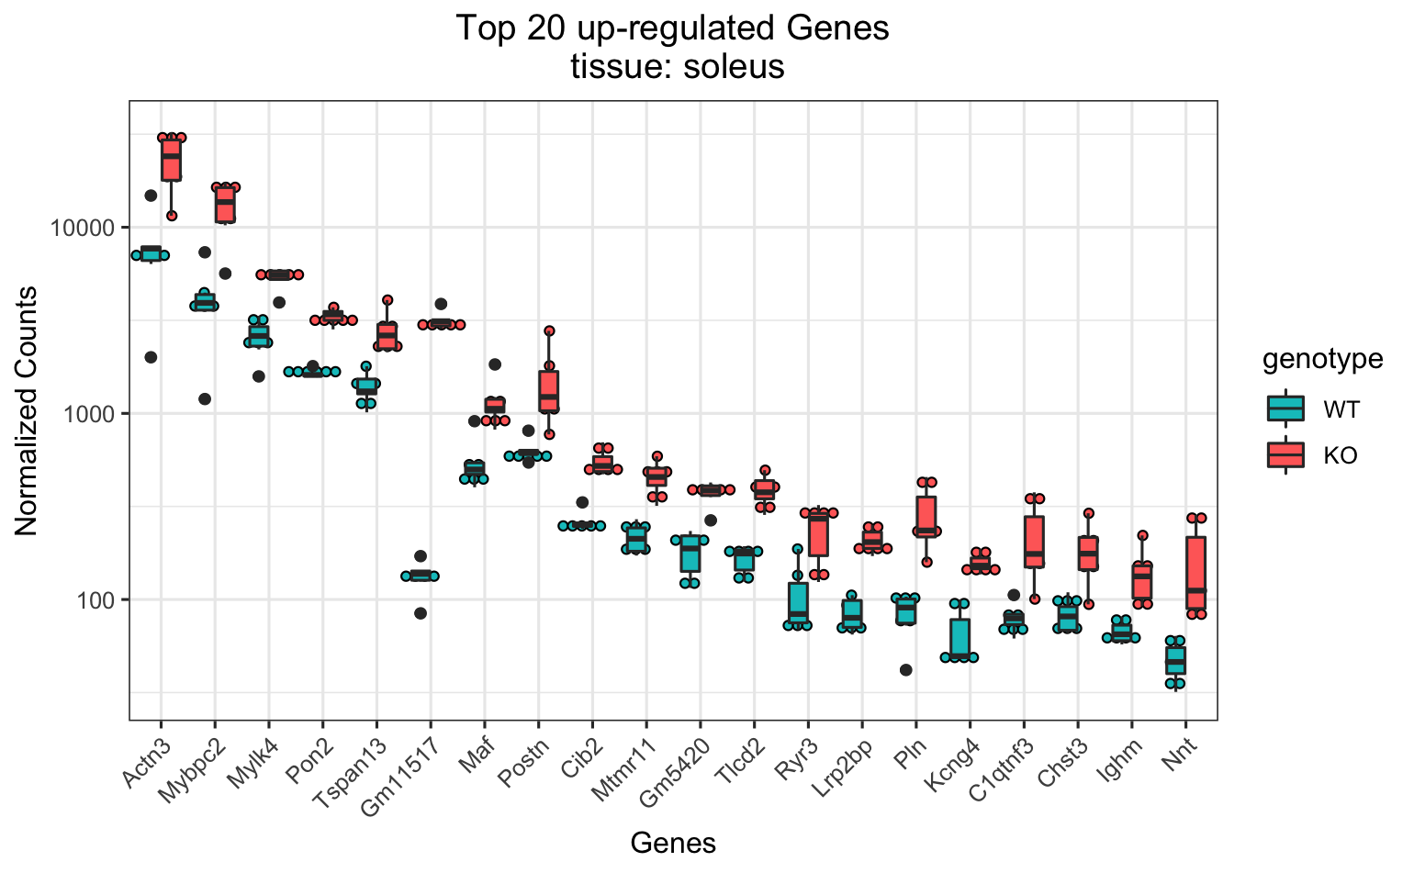
DEA: Top 20

Slide 11
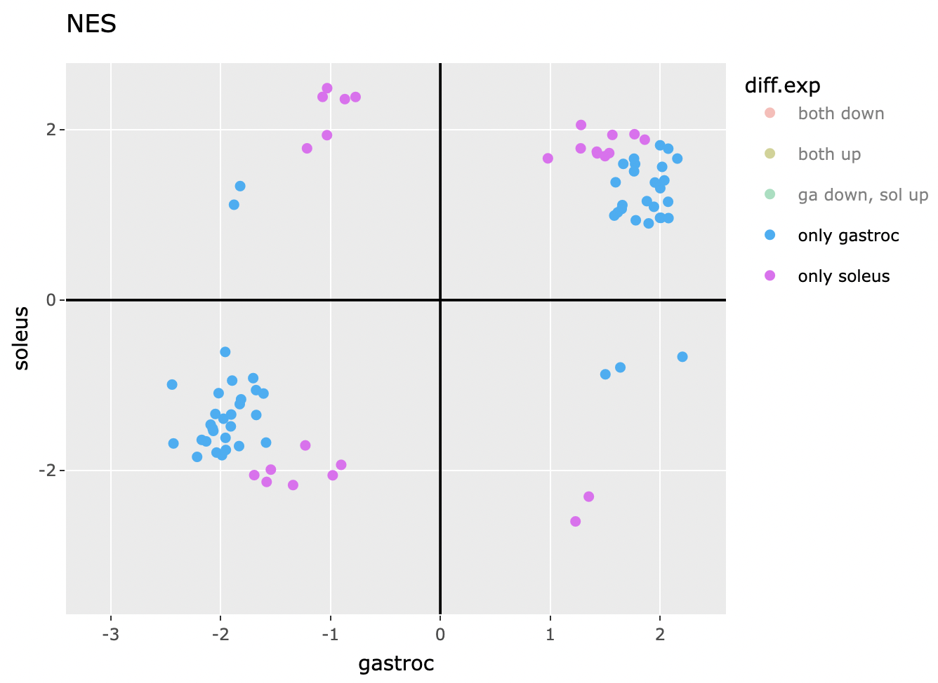
GSEA: most significant pathways
(Normalized Enrichment Score)
p-value only significant for one tissue!
Gene sets with adjusted p-value ≤ 0.01

Slide 12
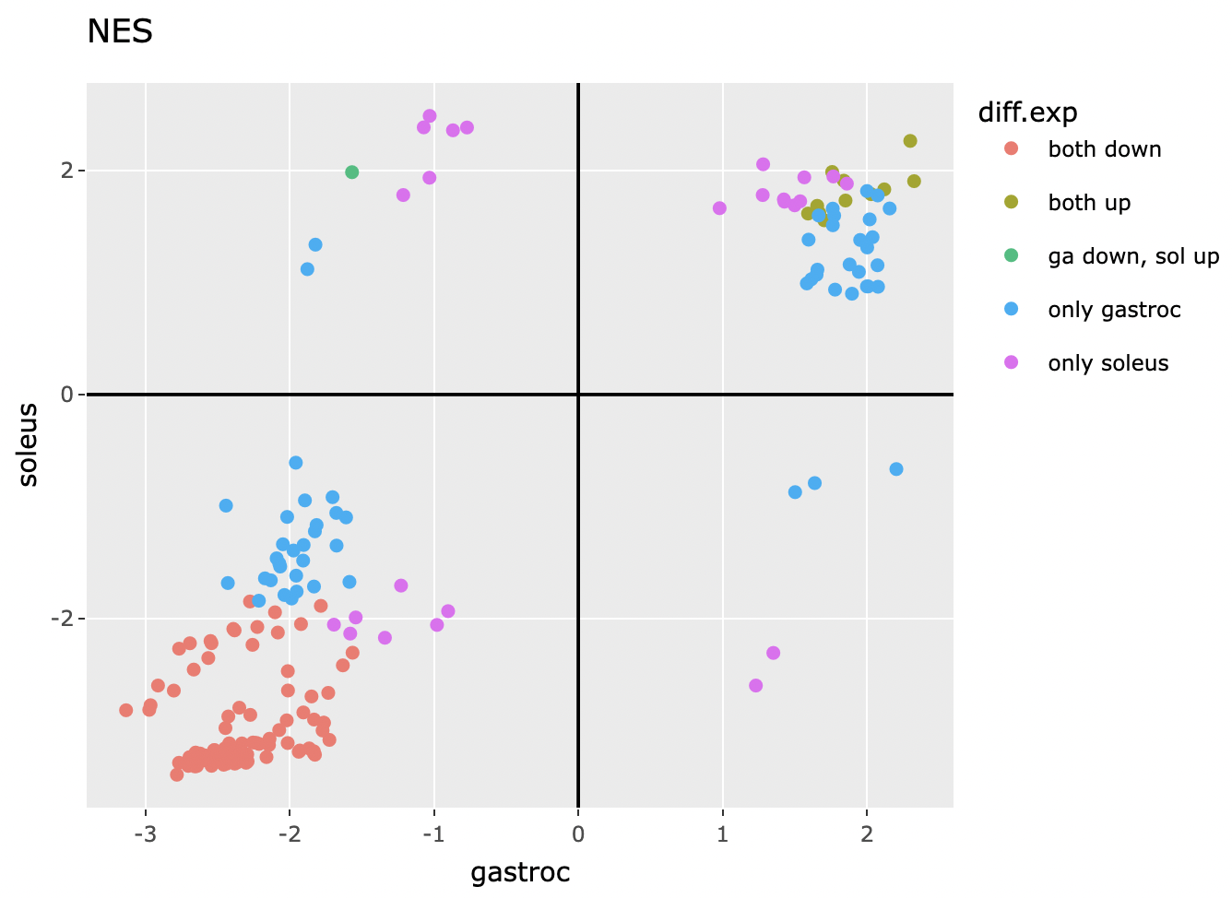
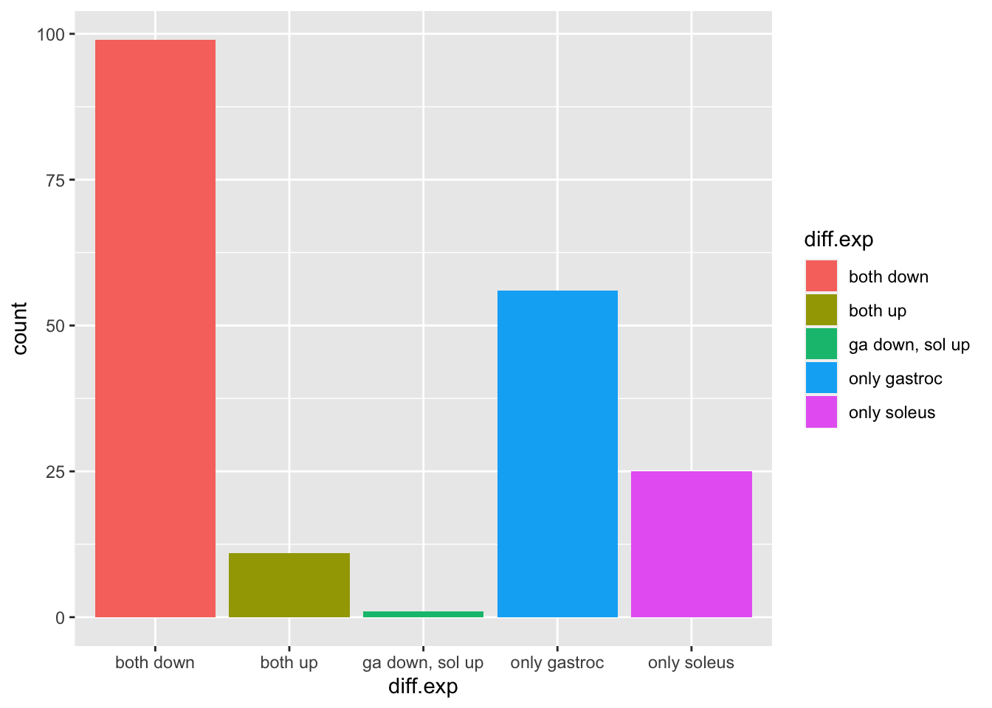
GSEA: most significant pathways
(Normalized Enrichment Score)
canonical pathways
MSigDB
database | gene sets
BioCarta | 252
Reactome | 1249
WikiPathways | 186
p-value only significant for one tissue!
Gene sets with adjusted p-value ≤ 0.01
Notes:
alt. title: most differential regulated pathways
Table for each group
(maybe also plot for each group), label those points
limit gene sets to 200 (already set)

Slide 13
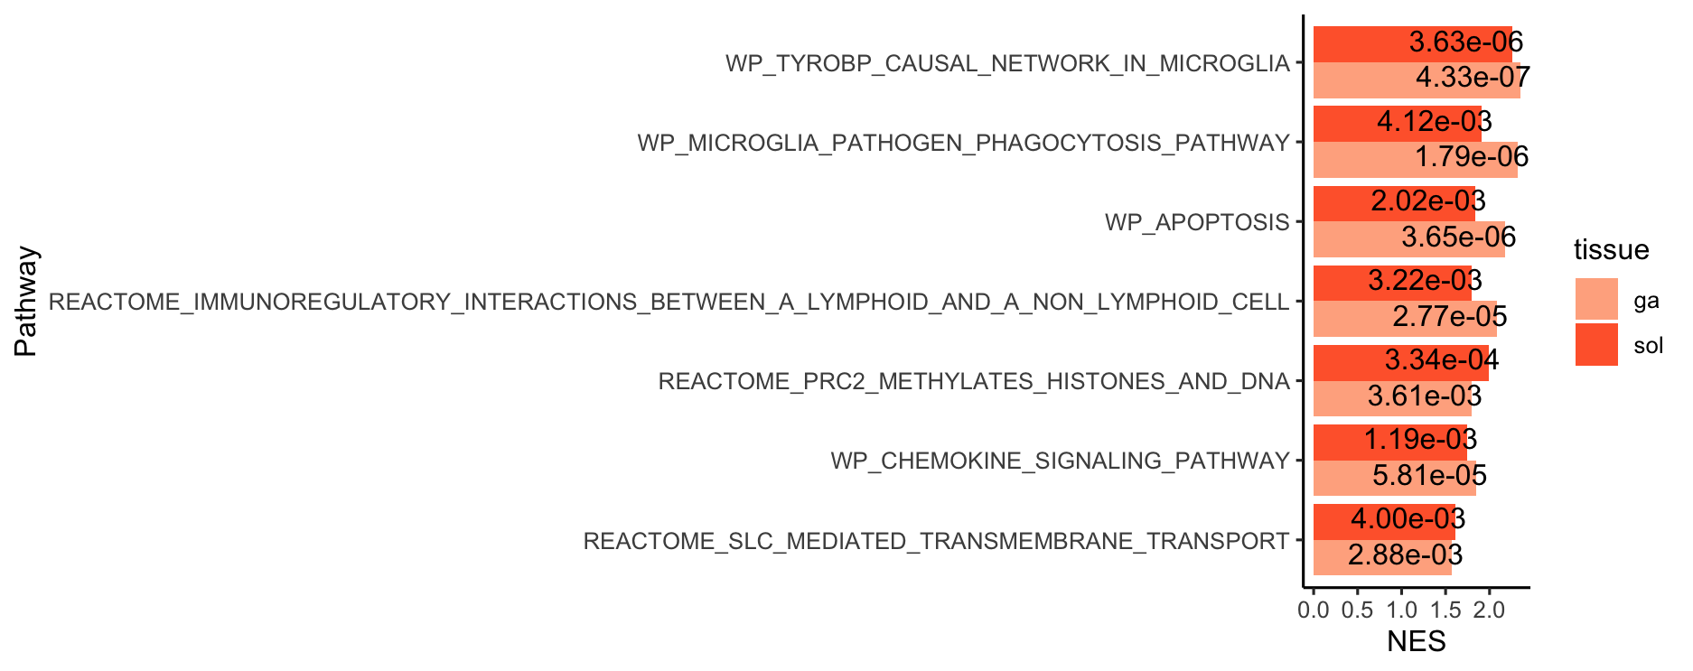
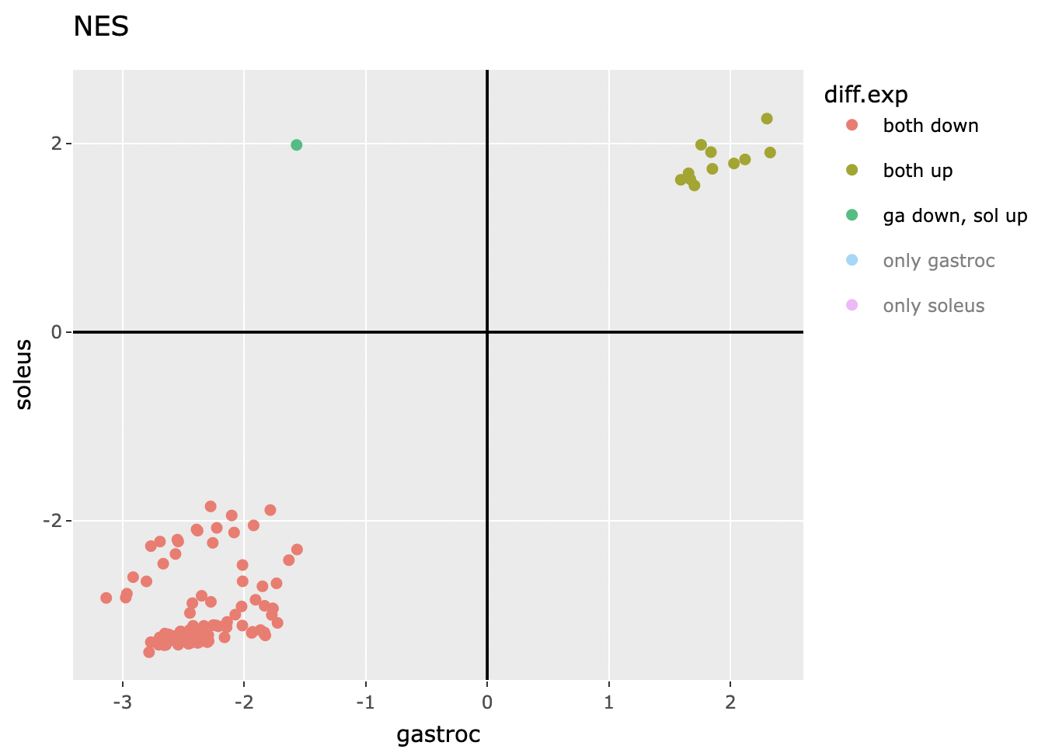
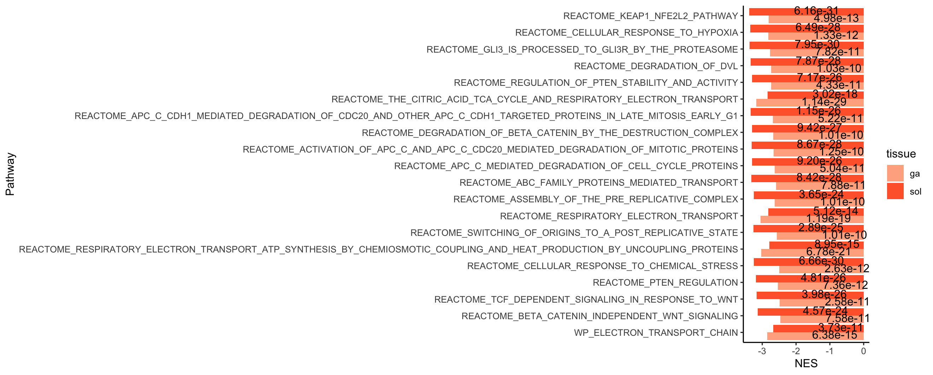
GSEA: most significant pathways
(Normalized Enrichment Score)
Gene sets with adjusted p-value ≤ 0.01
Notes:
Each single omics data is from a different cohort
every cohort was male except RNASeq

Slide 14
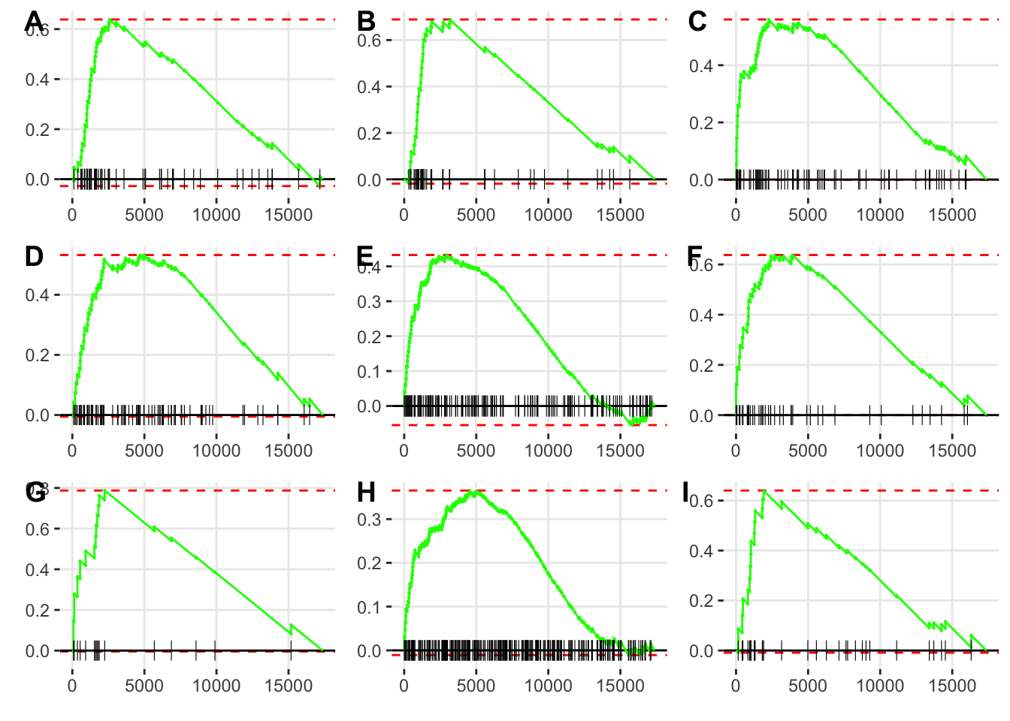
GSEA: gastroc upregulated
top 9 ESPs (enrichment score plot)
label | pathway
A | WP_TYROBP_CAUSAL_NETWORK_IN_MICROGLIA
B | WP_MICROGLIA_PATHOGEN_PHAGOCYTOSIS_PATHWAY
C | WP_APOPTOSIS
D | REACTOME_IMMUNOREGULATORY_INTERACIONS_BETWEEN_A_LYMPHOID_AND_A_NON_LYMPHOID_CELL
E | WP_CHEMOKINE_SIGNALING_PATHWAY
F | WP_FIBRIN_COMPLEMENT_RECEPTOR_3_SIGNALING_PATHWAY
G | BIOCARTA_TNFR2_PATHWAY
H | REACTOME_GPCR_LIGAND_BINDING
I | REACTOME_GPVI_MEDIATED_ACTIVATION_CASCADE

Slide 15
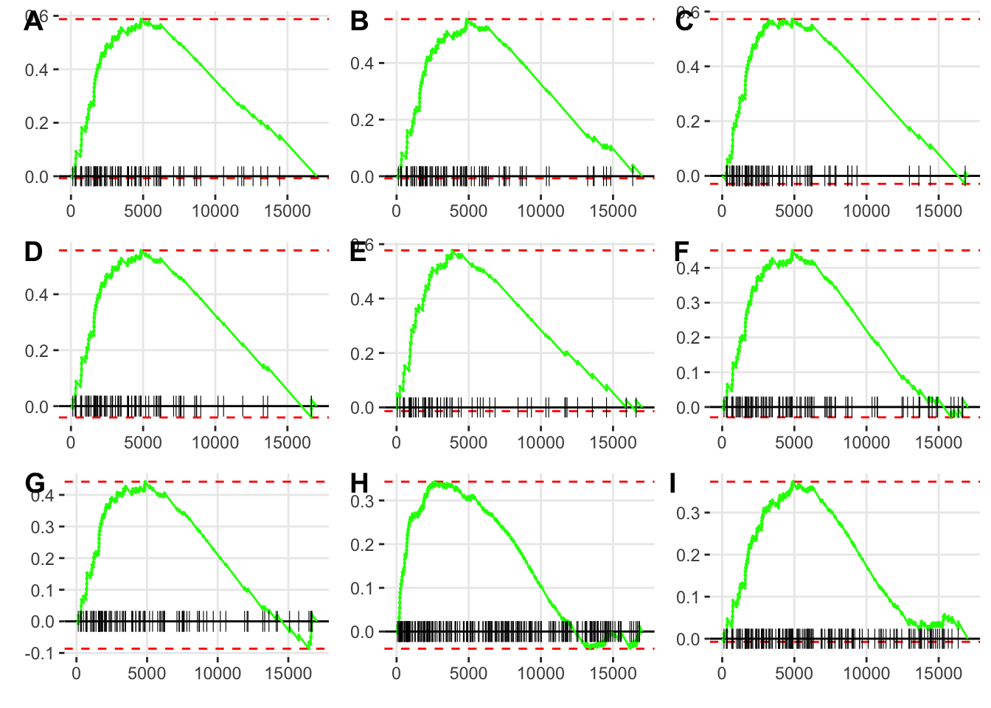
GSEA: soleus upregulated
top 9 ESPs
label | pathway
A | REACTOME_SRP_DEPENDENT_COTRANSLATIONAL_PROTEIN_TARGETING_TO_MEMBRANE
B | REACTOME_FORMATION_OF_A_POOL_OF_FREE_40S_SUBUNITS
C | WP_CYTOPLASMIC_RIBOSOMAL_PROTEINS
D | REACTOME_NONSENSE_MEDIATED_DECAY_NMD_INDEPENDENT_OF_THE_EXON_JUNCTION_COMPLEX_EJC
E | WP_TYROBP_CAUSAL_NETWORK_IN_MICROGLIA
F | REACTOME_EUKARYOTIC_TRANSLATION_INITIATION
G | REACTOME_NONSENSE_MEDIATED_DECAY_NMD
H | REACTOME_EXTRACELLULAR_MATRIX_ORGANIZATION
I | REACTOME_MAJOR_PATHWAY_OF_RRNA_PROCESSING_IN_THE_NUCLEOLUS_AND_CYTOSOL

Slide 16
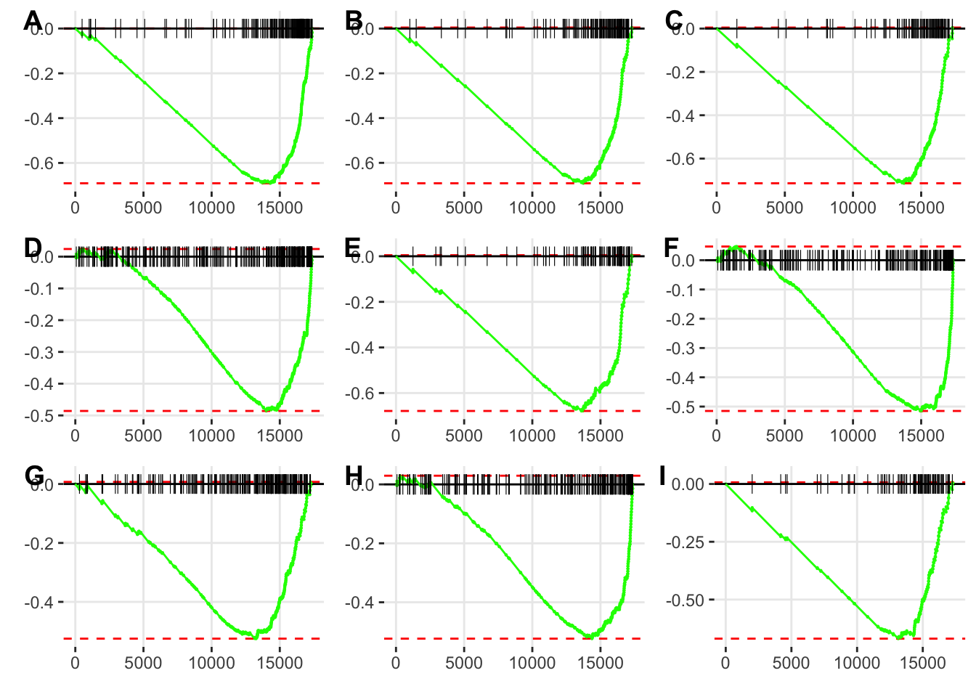
GSEA: gastroc downregulated
top 9 ESPs
label | pathway
A | REACTOME_THE_CITRIC_ACID_TCA_CYCLE_AND_RESPIRATORY_ELECTRON_TRANSPORT
B | REACTOME_RESPIRATORY_ELECTRON_TRANSPORT_ATP_SYNTHESIS_BY_CHEMIOSMOTIC_COUPLING_AND_HEAT_PRODUCTION_BY_UNCOUPLING_PROTEINS
C | REACTOME_RESPIRATORY_ELECTRON_TRANSPORT
D | REACTOME_ANTIGEN_PROCESSING_UBIQUITINATION_PROTEASOME_DEGRADATION
E | WP_ELECTRON_TRANSPORT_CHAIN
F | REACTOME_METABOLISM_OF_AMINO_ACIDS_AND_DERIVATIVES
G | REACTOME_TRANSLATION
H | REACTOME_NEDDYLATION
I | REACTOME_MITOCHONDRIAL_TRANSLATION

Slide 17
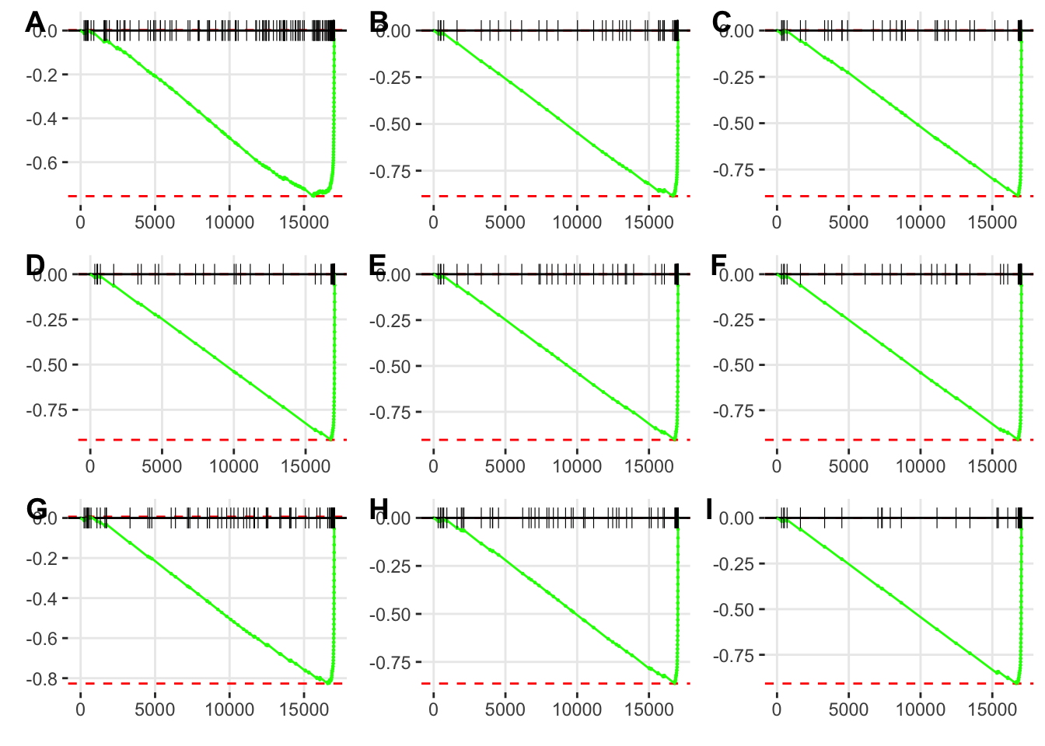
GSEA: soleus downregulated
top 9 ESPs
label | pathway
A | REACTOME_CELLULAR_RESPONSE_TO_CHEMICAL_STRESS
B | REACTOME_KEAP1_NFE2L2_PATHWAY
C | REACTOME_RUNX1_REGULATES_TRANSCRIPTION_OF_GENES_INVOLVED_IN_DIFFERENTIATION_OF_HSCS
D | REACTOME_GLI3_IS_PROCESSED_TO_GLI3R_BY_THE_PROTEASOME
E | REACTOME_ASYMMETRIC_LOCALIZATION_OF_PCP_PROTEINS
F | REACTOME_DEGRADATION_OF_DVL
G | REACTOME_ABC_FAMILY_PROTEINS_MEDIATED_TRANSPORT
H | REACTOME_ACTIVATION_OF_APC_C_AND_APC_C_CDC20_MEDIATED_DEGRADATION_OF_MITOTIC_PROTEINS
I | REACTOME_AUF1_HNRNP_D0_BINDS_AND_DESTABILIZES_MRNA

Slide 18
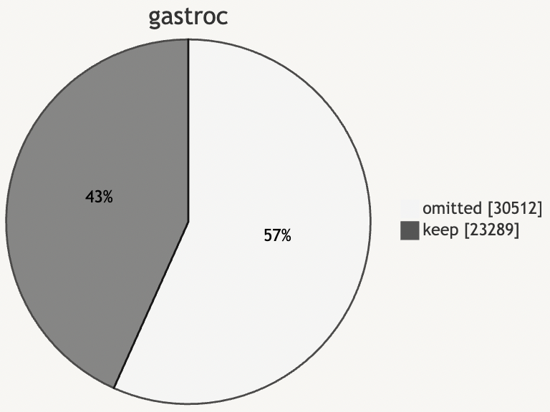
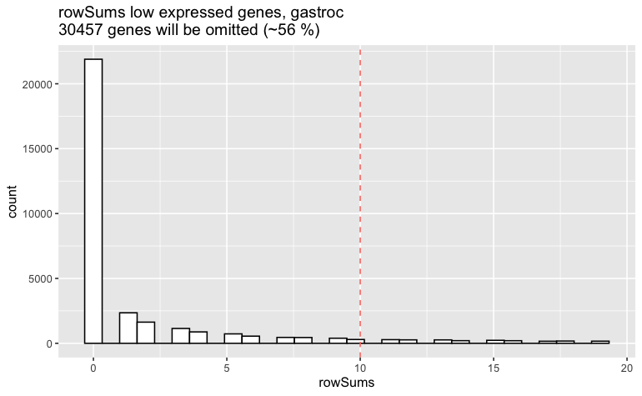
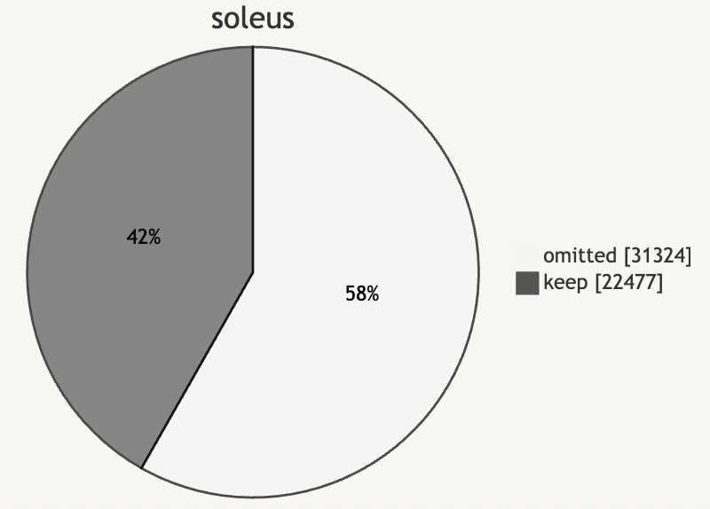
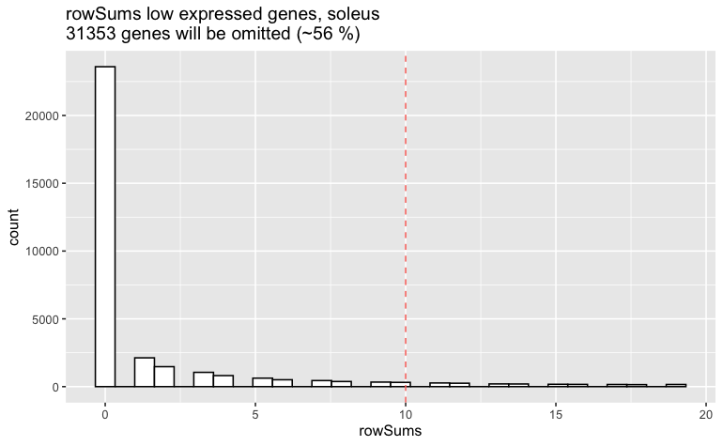
Appendix: data prep – zero counts
omitting zero-counts:
(≥ 3 per sample)
Notes:
Each single omics data is from a different cohort
every cohort was male except RNASeq

Slide 19
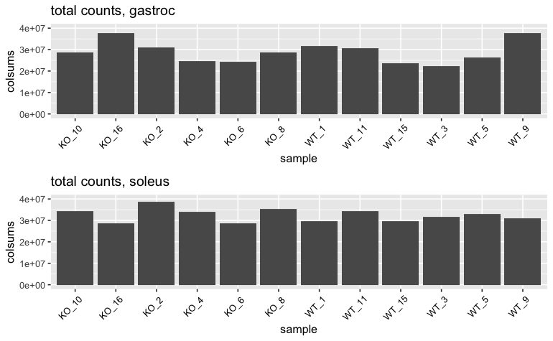
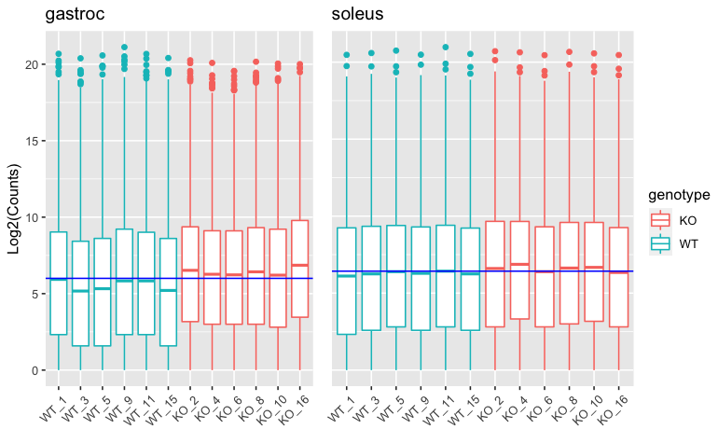
Appendix: data prep – check library sizes
library sizes
Count distributions
Notes:
Each single omics data is from a different cohort
every cohort was male except RNASeq

Slide 20


Appendix: annotation
GSEA: mouse pathways provided by MSigDB Collections
map data via entrez gene ids from ENSEMBL (BioMart) Database
Notes:
Each single omics data is from a different cohort
every cohort was male except RNASeq

Slide 21
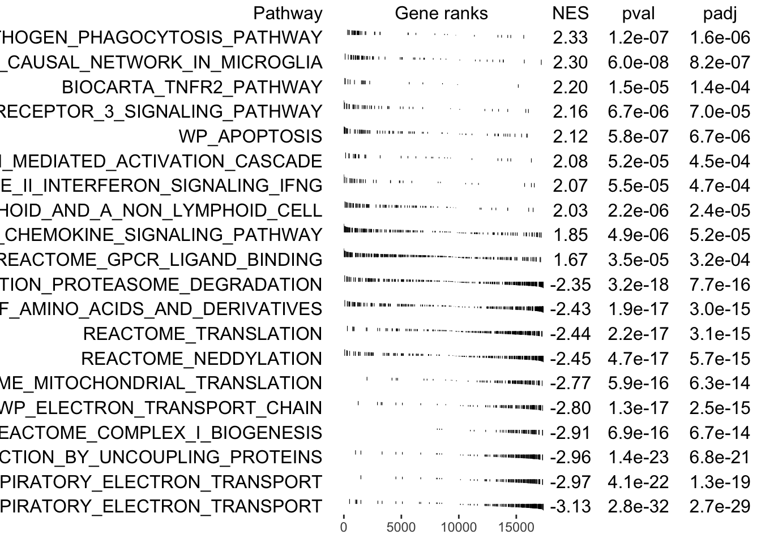
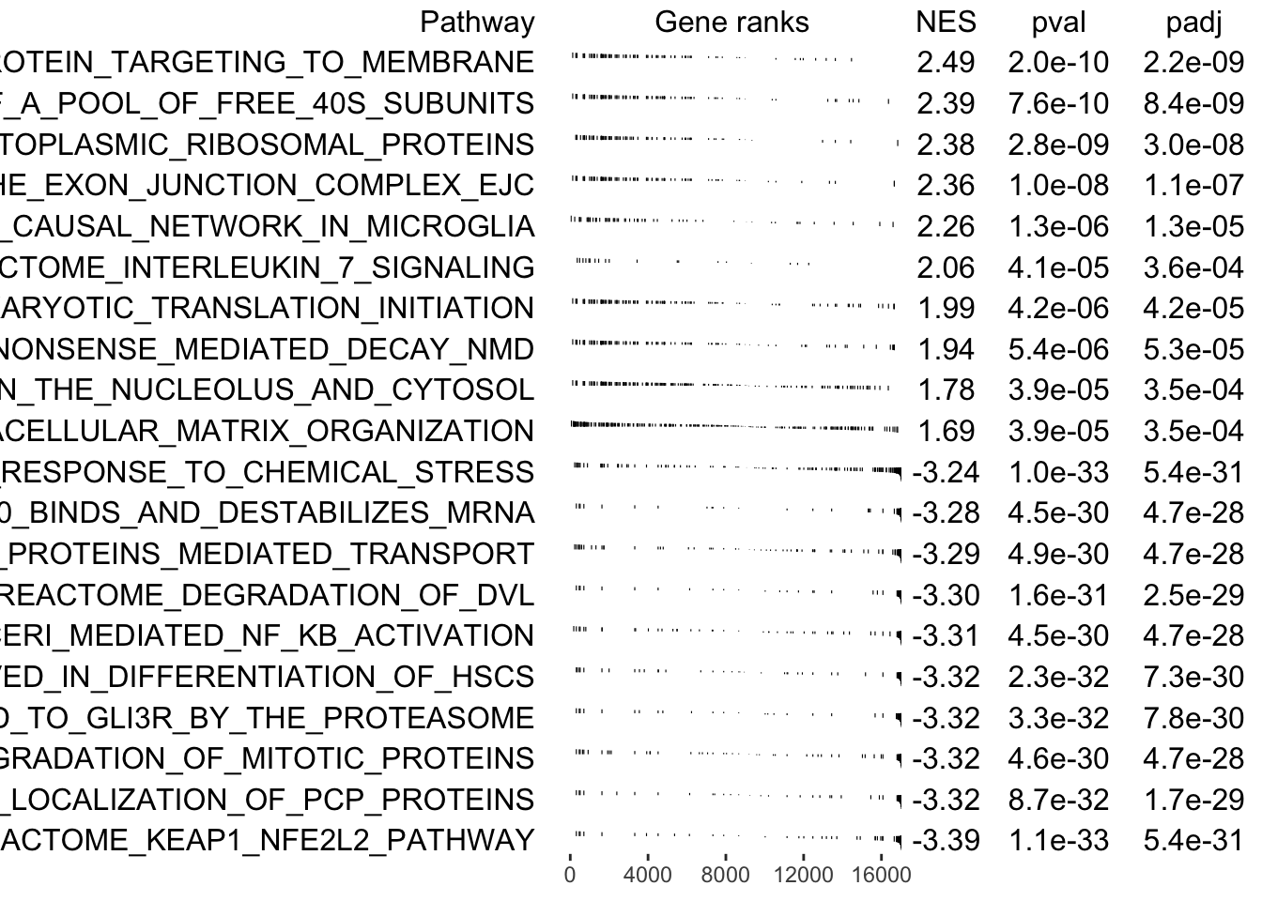
Appendix: GSEA table plot (top 20)
gastrocnemius
soleus
Notes:
Each single omics data is from a different cohort
every cohort was male except RNASeq

